Slide 2
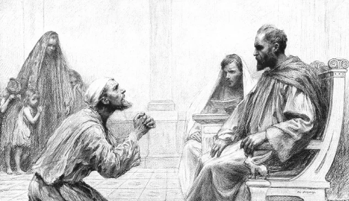
Jesus’ Teaching on Forgiveness

Slide 3
Jesus’ Teaching on Forgiveness
The Model Prayer
  Matt. 6:12, 14-15; Luke 11:4; Mark 11:25-26
The Parable of the Unforgiving Servant
  Matt. 18:21-35
Warning Against Offenses
  Luke 17:1-4

Slide 4

We must forgive…
Quickly
Completely
Sincerely
Repeatedly

