Slide 1
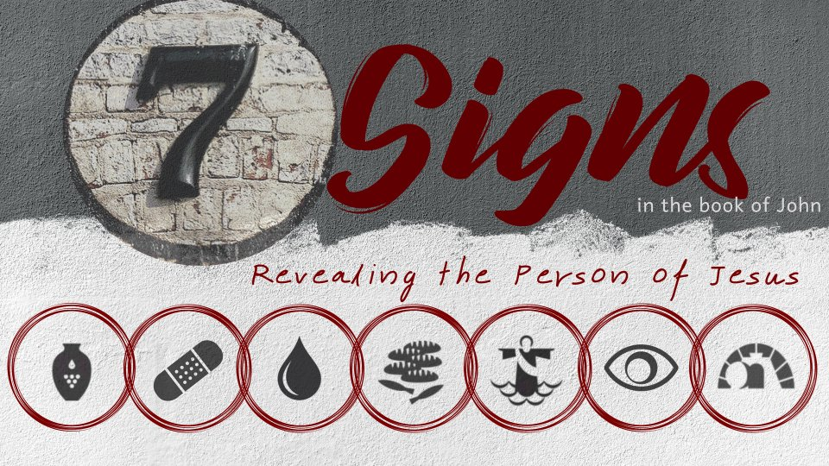
Feeding the Five Thousand
John 6:1-15

Slide 2
Only miracle recorded in all four gospel accounts.
Matthew 14:13-21
Mark 6:30-44
Luke 9:10-17
John 6:1-15

Slide 3
The Sign
After these things Jesus went over the Sea of Galilee, which is the Sea of Tiberias.
Then a great multitude followed Him, because they saw His signs which He performed on those who were diseased.

Slide 4
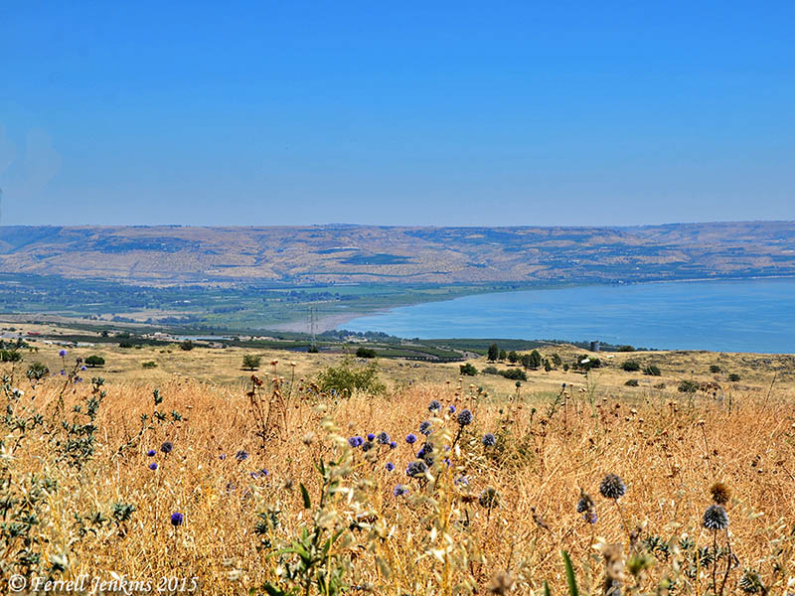
The Plain of Bethsaida
Luke 9:10

Slide 5
The Sign
And Jesus went up on the mountain, and there He sat with His disciples.
Now the Passover, a feast of the Jews, was near.
Then Jesus lifted up His eyes, and seeing a great multitude coming toward Him, He said to Philip, “Where shall we buy bread, that these may eat?”

Slide 6
The Sign
But this He said to test him, for He Himself knew what He would do.
Philip answered Him, “Two hundred denarii worth of bread is not sufficient for them, that every one of them may have a little.”

Slide 7
Luke 9:11-13
But when the multitudes knew it, they followed Him; and He received them and spoke to them about the kingdom of God, and healed those who had need of healing.
When the day began to wear away, the twelve came and said to Him, “Send the multitude away, that they may go into the surrounding towns and country, and lodge and get provisions; for we are in a deserted place here.”
But He said to them, “You give them something to eat.” And they said, “We have no more than five loaves and two fish, unless we go and buy food for all these people.”

Slide 8
The Sign
One of His disciples, Andrew, Simon Peter’s brother, said to Him,
“There is a lad here who has five barley loaves and two small fish, but what are they among so many?”

Slide 9
The Sign
Then Jesus said, “Make the people sit down.” Now there was much grass in the place. So the men sat down, in number about five thousand.
And Jesus took the loaves, and when He had given thanks He distributed them to the disciples, and the disciples to those sitting down; and likewise of the fish, as much as they wanted.

Slide 10
The Sign
So when they were filled, He said to His disciples, “Gather up the fragments that remain, so that nothing is lost.”
Therefore they gathered them up, and filled twelve baskets with the fragments of the five barley loaves which were left over by those who had eaten.

Slide 11
The Impact of the Sign
Then those men, when they had seen the sign that Jesus did, said, “This is truly the Prophet who is to come into the world.”
Therefore when Jesus perceived that they were about to come and take Him by force to make Him king, He departed again to the mountain by Himself alone.

Slide 12
The Impact of the Sign
Then those men, when they had seen the sign that Jesus did, said, “This is truly the Prophet who is to come into the world.”
Therefore when Jesus perceived that they were about to come and take Him by force to make Him king, He departed again to the mountain by Himself alone.

Slide 13
The Impact of the Sign
Then those men, when they had seen the sign that Jesus did, said, “This is truly the Prophet who is to come into the world.”
Therefore when Jesus perceived that they were about to come and take Him by force to make Him king, He departed again to the mountain by Himself alone.

Slide 14
What This Sign Tells Us About Jesus
Jesus is the master over quantity.
Jesus had provided wine for an entire wedding party (John 2), but this was a multitude of over 5,000 men (plus women and children).
Both Philip and Andrew noted it was impossible to feed this multitude.
After allowing that fact to be established in their minds, Jesus fed the multitude with a boy’s lunch and they had 12 baskets of fragments left over.

