Slide 1
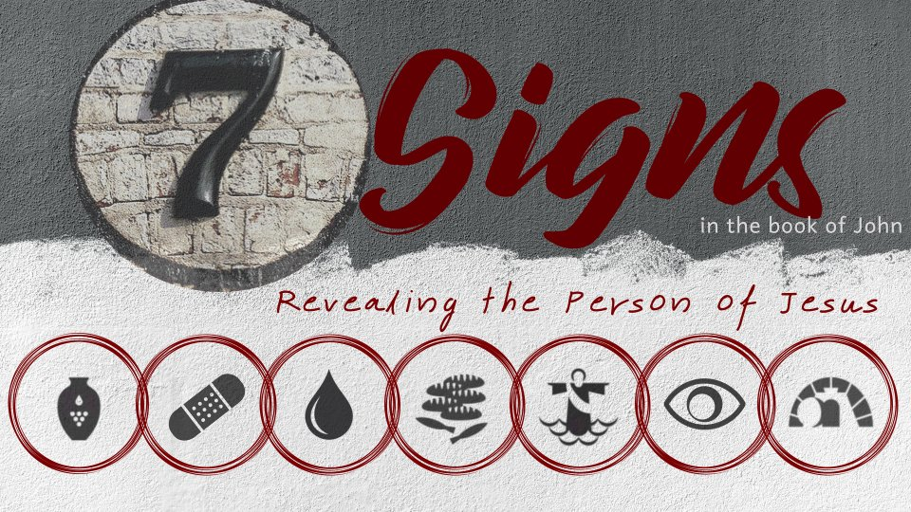
Healing the Lame Man
John 5:1-16

Slide 2
The Sign
A feast in Jerusalem (v. 1)
The pool of Bethesda by the Sheep Gate (v. 2)
Great multitude of sick people (v. 3)
The lame man (v. 5)
Jesus’ question (v. 6)
Jesus’ command (vs. 8-9)

Slide 3
The Impact of the Sign
John focuses on the impact this sign had on the Jewish leaders.
  “The Jews therefore said to him who was cured, ‘It is the Sabbath; it is not lawful for you to carry your bed’” (v. 10).
It introduces the conflict that will result in the Lord’s crucifixion.
  “For this reason the Jews persecuted Jesus, and sought to kill Him, because He had done these things on the Sabbath” (v. 16).

Slide 4
What This Sign Tells Us About Jesus
Jesus has power over time.
Jesus knows what people are experiencing.
Jesus places importance on our spiritual condition.
Jesus places importance on doing the Father’s will.

