Slide 2
Hide and Seek with God
Hebrews 11:6

Slide 3
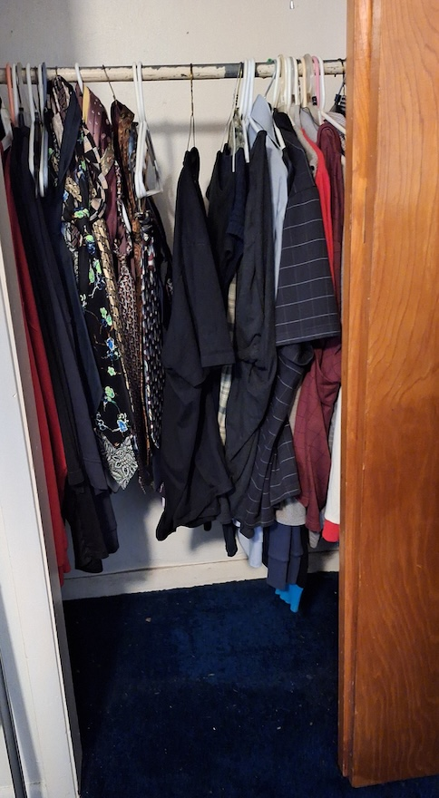

Bedroom Closet
He has so many secrets, but I know
  Colossians 1:24-28
    Ephesians 2:19
    2nd Timothy 3:16-17
  Matthew 24:35-36, 42

Slide 4
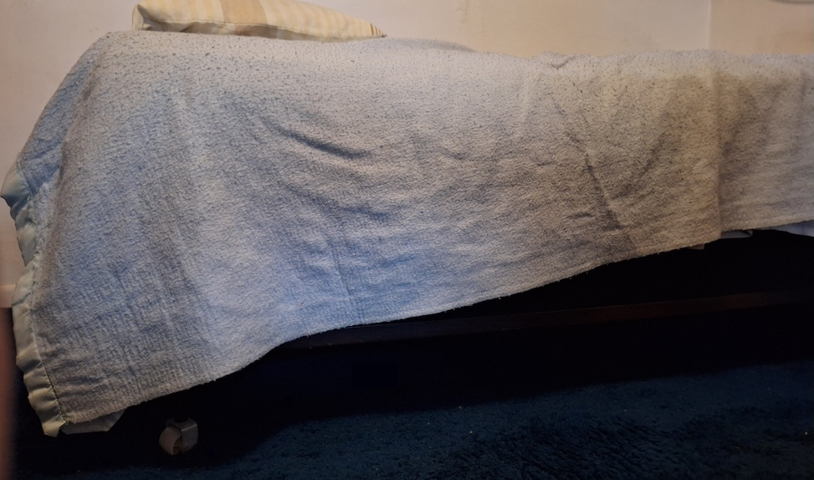
Under the Bed
He’s out to get you.
Deuteronomy 32:23-26, 20-21
Leviticus 6:7
Colossians 1:13-15

Slide 5
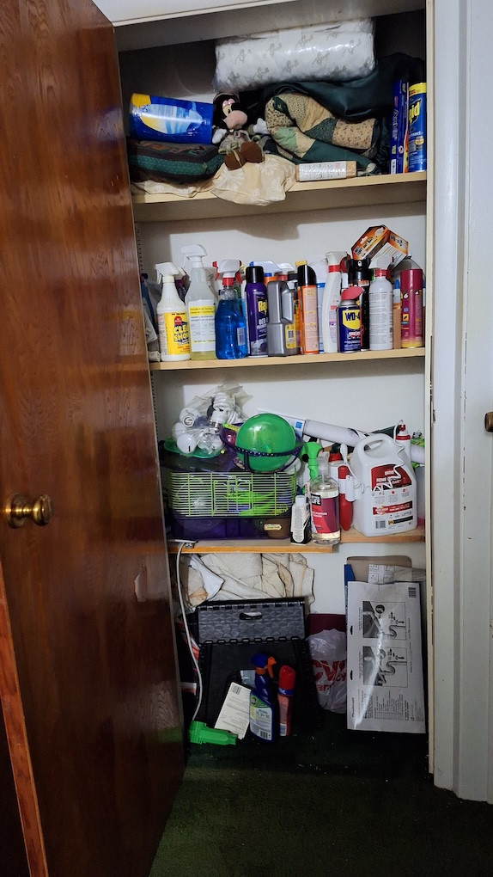
Cleaning Closet
Everyone will be spotless. Always.
1 John 1:9, 7
  Hebrews 5:9
  Act 8:20-23

Slide 6
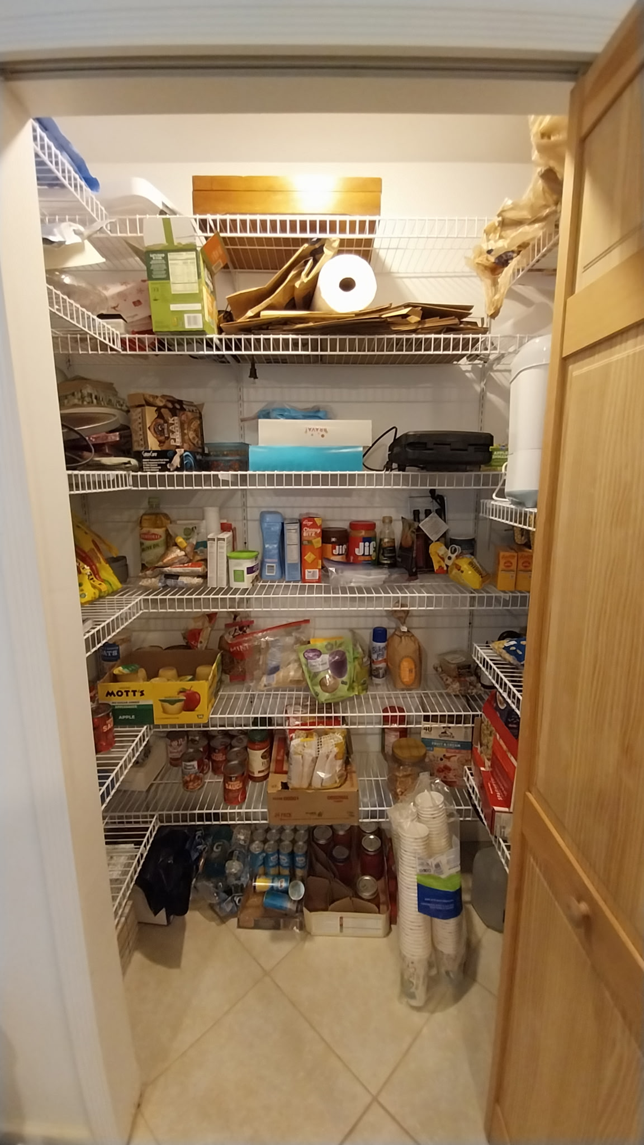
Food Pantry
He only wants you to feel good and loved
Ephesians 1:3
Matthew 13:41-43

Slide 7
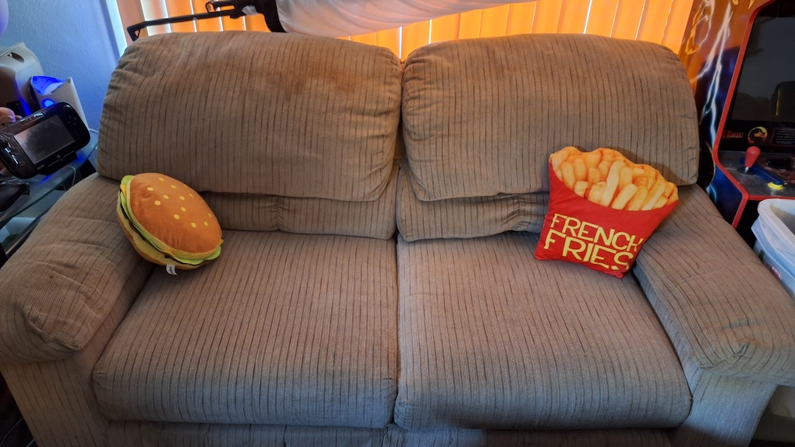
Living Room Couch
Keep it as easy as possible. Let’s just relax. Talk about feelings.
Matthew 11:29-30
John 11:35
2nd Corinthians 1:5-7

Slide 8
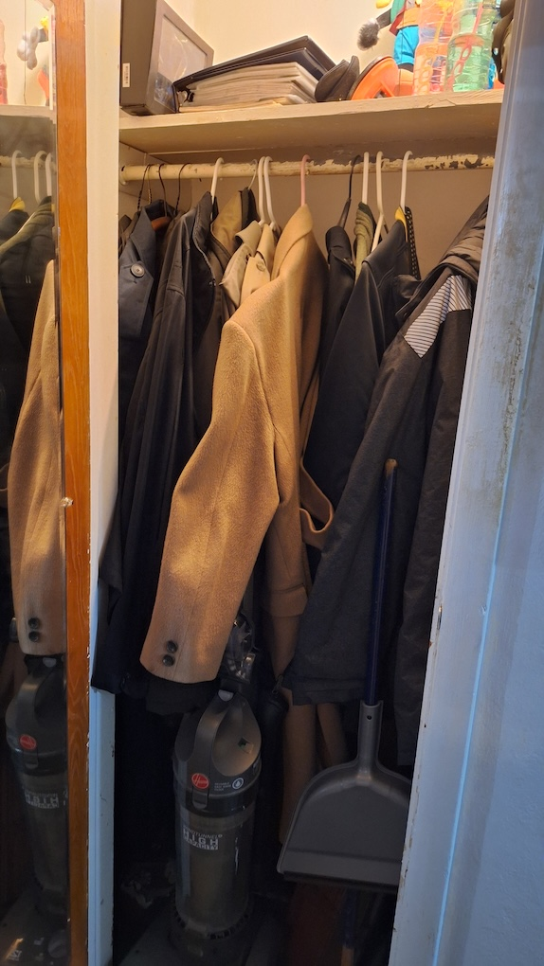
Coat Closet
He’ll protect you, no matter what you wear.
Ephesians 6:10-13

Slide 9
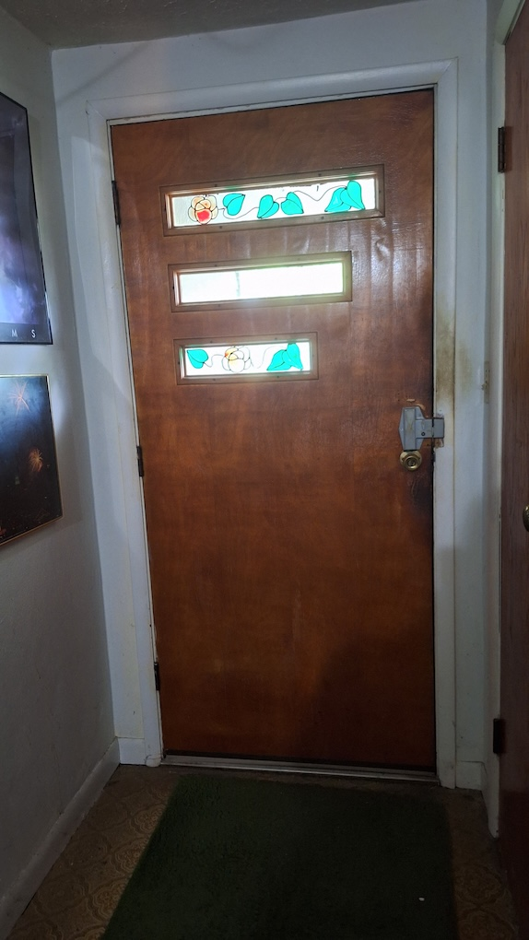
Front Door
He’s been waiting all this time
You need to let him in.
Revelation 3:20

