Slide 2
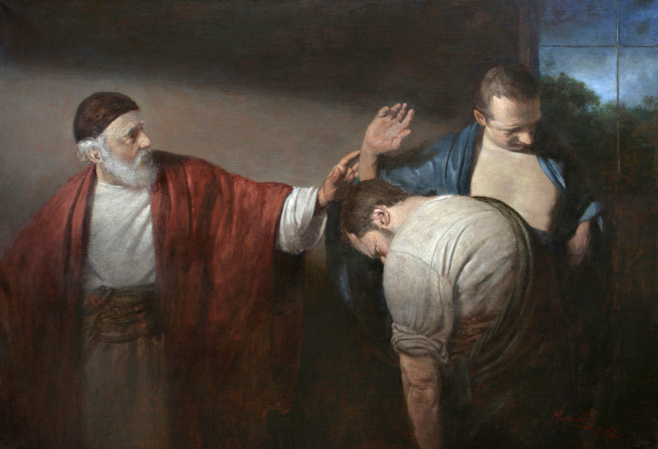
The Parable of the Two Sons
Matthew 21:28-32

Slide 3
The Surface Lesson
God gave His commands to the nation of Israel.
Some blatantly disregarded God’s commands (tax collectors and harlots).
Others professed a high regard for God’s commands, but cast them aside in favor of their own traditions (scribes and Pharisees).
When John the Baptist preached, many of the blatant sinners repented, but only a few of the scribes, Pharisees, chief priests and elders were brought to repentance.

Slide 4
Other Lessons
Jesus did not endorse delayed obedience.
Words are important, but obedience requires our works.
God welcomes our repentance.
God condemns hypocrisy.

