Slide 1
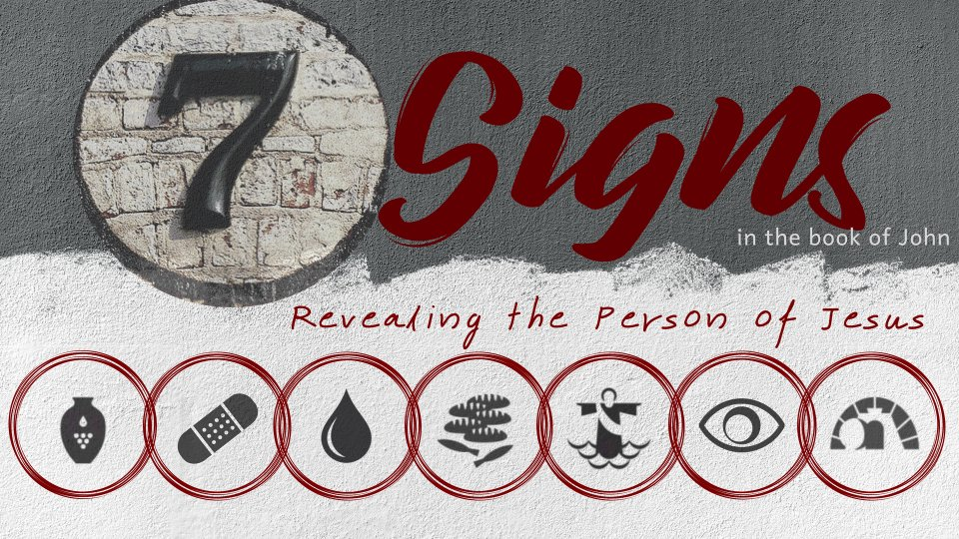
Healing the Nobleman’s Son
John 4:46-54

Slide 2
John’s Gospel Focuses on Belief
“His disciples believed in Him (2:11)
“many believed in His name when they saw the signs which He did” (2:24)
Nicodemus believed Jesus was “a teacher come from God” because of His signs (3:2)
A city of the Samaritans believed (4:39-42)
Some Galileans believed because they had seen
His signs, but others weren’t as easily convinced (4:43-45)

Slide 3

So Jesus came again to Cana of Galilee where He had made the water wine. And there was a certain nobleman whose son was sick at Capernaum.
When he heard that Jesus had come out of Judea into Galilee, he went to Him and implored Him to come down and heal his son, for he was at the point of death.

Slide 4
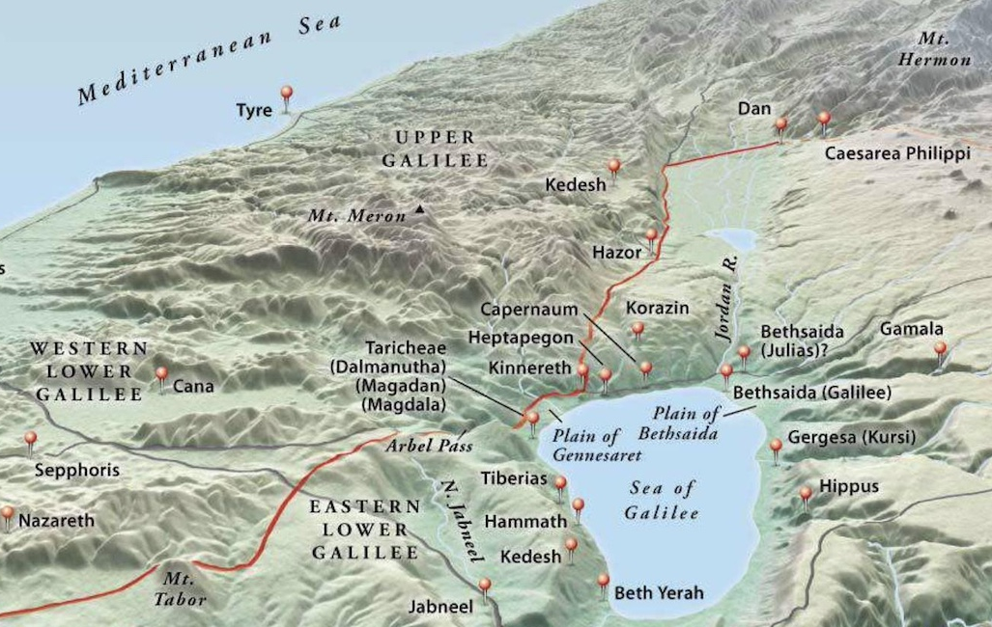
“come down”
Cana was 16-25 miles SW of Capernaum.
Cana - 2,849 feet above sea level.
Capernaum - 683 feet below sea level.

Slide 5
Then Jesus said to him, “Unless you people see signs and wonders, you will by no means believe.”
The nobleman said to Him, “Sir, come down before my child dies!”
Jesus said to him, “Go your way; your son lives.” So the man believed the word that Jesus spoke to him, and he went his way.

Slide 6
And as he was now going down, his servants met him and told him, saying, “Your son lives!”
Then he inquired of them the hour when he got better. And they said to him, “Yesterday at the seventh hour the fever left him.”
So the father knew that it was at the same hour in which Jesus said to him, “Your son lives.” And he himself believed, and his whole household.

Slide 7

The Progression of the Nobleman’s Faith
He believed in the power of Jesus because of the reports.
He believed the words Jesus spoke.
He believed in Jesus.
He shared this belief with others.

Slide 8
What This Sign Tells Us About Jesus
Jesus has power over distance.
Physical distance is an obstacle to us. We can’t be in two places at once.
This is no obstacle to One who is exercising absolute divine authority!
Matthew 8:5-10

Slide 9
Important Lessons
Jesus doesn’t have to do things our way to get them done.
Jesus can be trusted with our most precious possessions and our most pressing problems.
Jesus has power over distance.
  He may be in Heaven, but He is with us always!

