Slide 2
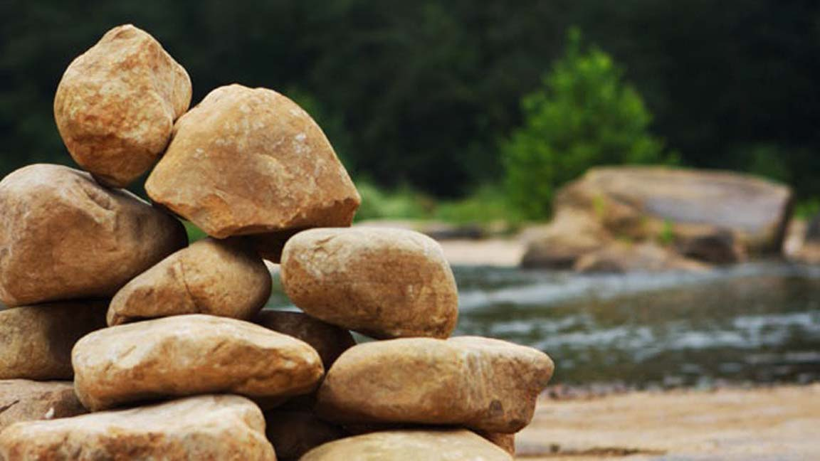
The Memorial Stones
Joshua 4

Slide 3
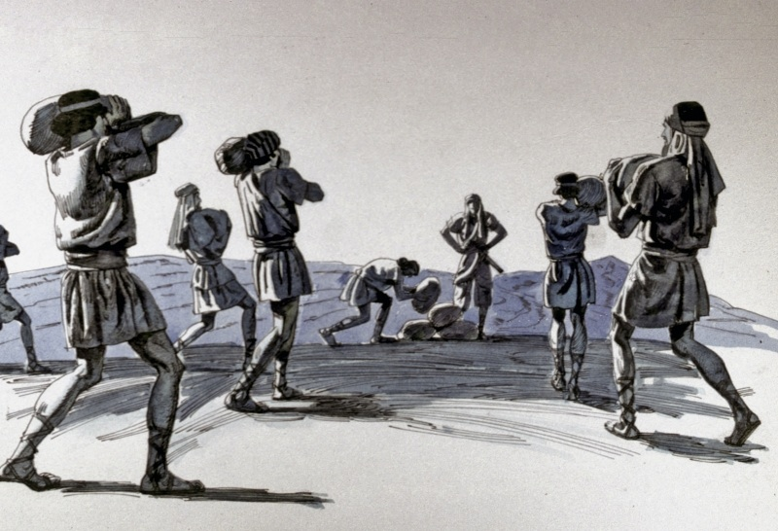
One man from each of the 12 tribes took a large stone from the riverbed.
Joshua set up these stones in Gilgal as a memorial that could easily be seen.
These stones were to play an important role in the future of the nation.

Slide 4
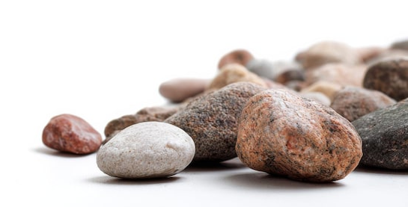
These Stone Would Speak
God’s Power
God’s Provision

Slide 5
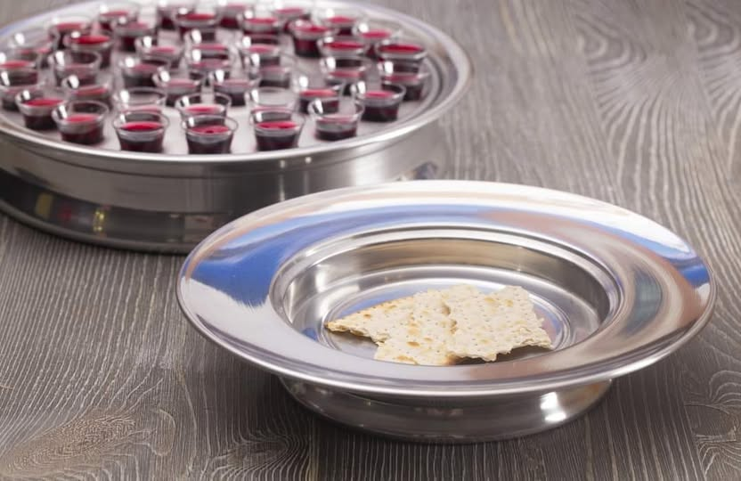
The Christian’s Memorial
The Lord’s Supper
1 Corinthians 11:23-26

Slide 6
Israel’s Failure
Judges 2:7-12
The stones were still there, but the fathers didn’t teach their children (Ps. 78:5-8).
“And, ye fathers, provoke not your children to wrath: but bring them up in the nurture and admonition of the Lord” (Eph. 6:4, KJV).

Slide 7
The Memorial Stones
Joshua 4:6-7
…when your children ask in time to come, saying,
“What do these stones mean to you?”
Then you shall answer them that the waters of the Jordan were cut off before the ark of the covenant of the Lord;
when it crossed over the Jordan… And these stones shall be for a memorial to the children of Israel forever.

