Slide 2

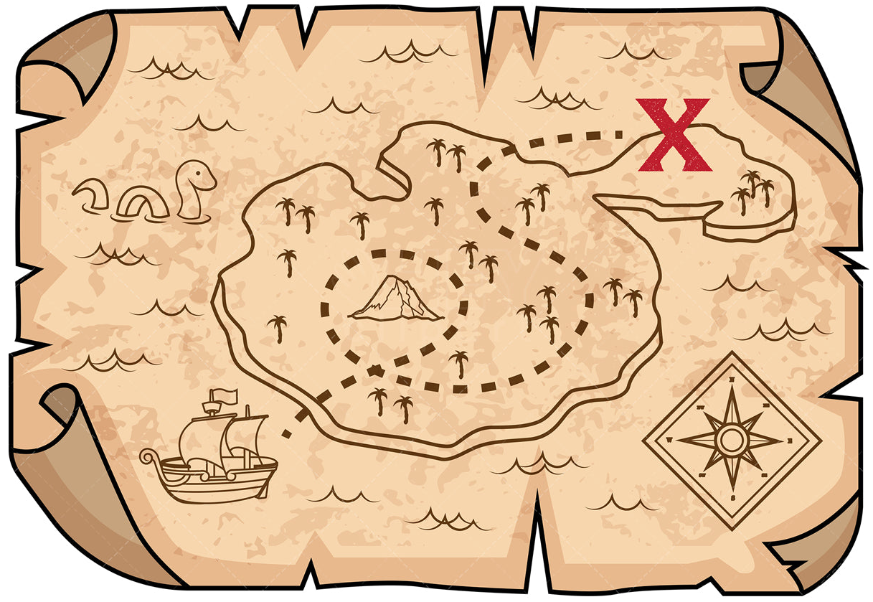
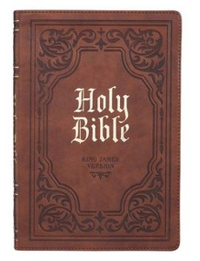
Treasure Hunters
Bible Edition

Slide 3

1. The Bible
“I rejoice at Your word as one who finds great treasure” (Ps. 119:162).
Psalm 19:10
2 Corinthians 4:7

Slide 4
2. Knowing Christ
Paul preached “the unsearchable riches of Christ” (Eph. 3:8).
Paul made it his life’s goal to lay hold of these riches (Phil. 3:7-14).

Slide 5
3. The Kingdom of God
“Again, the kingdom of heaven is like treasure hidden in a field, which a man found and hid; and for joy over it he goes and sells all that he has and buys that field” (Matt. 13:44).

Slide 6
4. Wisdom
Proverbs 2:1-5; 16:16
“Oh, the depth of the riches both of the wisdom and knowledge of God! How unsearchable are His judgments and His ways past finding out!” (Rom. 11:33).

Slide 7
5. Good Reputation
“A good name is to be chosen rather than great riches, loving favor rather than silver and gold” (Prov. 22:1).
Ecclesiastes 7:1

Slide 8
6. Good Spouse and Family
“An excellent wife who can find? She is far more precious than jewels” (Prov. 30:10, ESV).
Proverbs 12:4; 18:22
1 Peter 3:7
Psalm 127:3
Psalm 128

Slide 9
Finding God’s Treasures
The Bible
Knowing Christ
The Kingdom of God
Wisdom
Good Reputation
Good Spouse and Family

