Slide 2
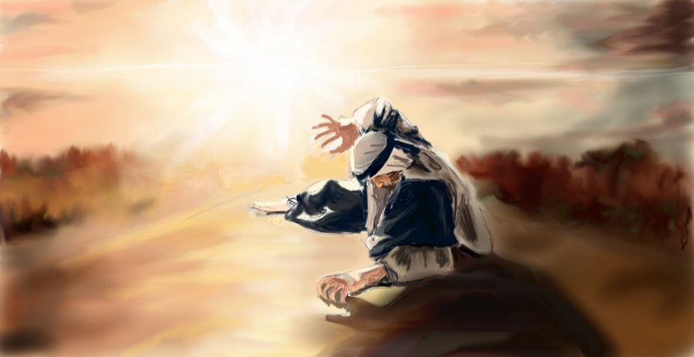
When Saul Saw the Light
Acts 9:1-19; 22:1-16; 26:12-18

Slide 3
Saul of Tarsus
“And I advanced in Judaism beyond many of my contemporaries in my own nation, being more exceedingly zealous for the traditions of my fathers” (Gal. 1:14).
“Circumcised the eighth day, of the stock of Israel, of the tribe of Benjamin, a Hebrew of the Hebrews; concerning the law, a Pharisee; concerning zeal, persecuting the church; concerning the righteousness which is in the law, blameless”
(Phil. 3:5-6).

Slide 4
Saul of Tarsus
And since I could not see for the glory of that light, being led by the hand of those who were with me, I came into Damascus.
Then a certain Ananias, a devout man according to the law, having a good testimony with all the Jews who dwelt there,
came to me; and he stood and said to me, “Brother Saul, receive your sight.” And at that same hour I looked up at him.
Acts 22:11-13

Slide 5
1. He Was Wrong
“Then Paul, looking earnestly at the council, said, ‘Men and brethren, I have lived in all good conscience before God until this day’” (Acts 23:1).
“I am indeed a Jew, born in Tarsus of Cilicia, but brought up in this city at the feet of Gamaliel, taught according to the strictness of our fathers’ law, and was zealous toward God as you all are today. I persecuted this Way to the death, binding and delivering into prisons both men and women” (Acts 22:3-4).

Slide 6
1. He Was Wrong
“Then Paul, looking earnestly at the council, said, ‘Men and brethren, I have lived in all good conscience before God until this day’” (Acts 23:1).
“I am indeed a Jew, born in Tarsus of Cilicia, but brought up in this city at the feet of Gamaliel, taught according to the strictness of our fathers’ law, and was zealous toward God as you all are today. I persecuted this Way to the death, binding and delivering into prisons both men and women” (Acts 22:3-4).
“For if when we were enemies we were reconciled to God through the death of His Son, much more, having been reconciled, we shall be saved by His life.”
Romans 5:10

Slide 7
2. He Could Be Saved
“Arise and go into the city, and you will be told what you must do” (Acts 9:6).
“And now why are you waiting? Arise and be baptized, and wash away your sins, calling on the name of the Lord” (Acts 22:16).
If Saul of Tarsus could be saved, anyone can be saved (1 Tim. 1:13-16)!

Slide 8
3. He Would Have to Change
Acts 22:14-15; 26:16-20
“But they were hearing only, ‘He who formerly persecuted us now preaches the faith which he once tried to destroy’” (Galatians 1:23).
We have to change (Eph. 4:25-5:13).

Slide 9
4. He Would Face and
Overcome Difficulties
“But the Lord said to him, ‘Go, for he is a chosen vessel of Mine to bear My name before Gentiles, kings, and the children of Israel. For I will show him how many things he must suffer for My name’s sake” (Acts 9:15-16).

Slide 10
4. He Would Face and
Overcome Difficulties
“For these reasons the Jews seized me in the temple and tried to kill me. Therefore, having obtained help from God, to this day I stand, witnessing both to small and great, saying no other things than those which the prophets and Moses said would come” (Acts 26:21-22).

Slide 11
4. He Would Face and
Overcome Difficulties
If anyone comes to Me and does not hate his father and mother, wife and children, brothers and sisters, yes, and his own life also, he cannot be My disciple.
And whoever does not bear his cross and come after Me cannot be My disciple.
For which of you, intending to build a tower, does not sit down first and count the cost, whether he has enough to finish it.
Luke 14:26-28

Slide 12
What Did Saul See?
We can be wrong.
We can be saved.
We will have to change.
We will face and overcome difficulties.

