Slide 2

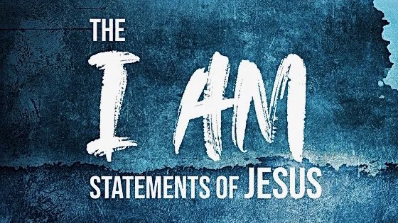
I am the Root and the Offspring of David
Revelation 22:16

Slide 3
Root and Offspring
Root (rhiza) refers metaphorically to the “cause, origin, source” of persons of things.
Offspring (genos) refers to a descendant, one who comes from another.

Slide 4
Root and Offspring
Root (rhiza) refers metaphorically to the “cause, origin, source” of persons of things.
Offspring (genos) refers to a descendant, one who comes from another.
David
Matthew 22:41-45

Slide 5
Root and Offspring
Root (rhiza) refers metaphorically to the “cause, origin, source” of persons of things.
Offspring (genos) refers to a descendant, one who comes from another.
The Word
John 1:1
David
Matthew 22:41-45

Slide 6
Root and Offspring
Root (rhiza) refers metaphorically to the “cause, origin, source” of persons of things.
Offspring (genos) refers to a descendant, one who comes from another.
The Word
John 1:1
David
Matthew 22:41-45
Jesus
Rom. 1:3

Slide 7
Promise Made to David
2 Samuel 7:12-16
God promised to build a house (dynasty or lineage of kings) for David.

Slide 8
Promise Confirmed by God with a Covenant
I have made a covenant with My chosen, I have sworn to My servant David:
Your seed I will establish forever, and build up your throne to all generations.
Psalm 89:3-4

Slide 9
Promise Confirmed by God with a Covenant
The Lord has sworn in truth to David; He will not turn from it: “I will set upon your throne the fruit of your body.
If your sons will keep My covenant and My testimony which I shall teach them, their sons also shall sit upon your throne forevermore.”
Psalm 132:11-12

Slide 10
Promise Kept Alive
Through the Prophets

Slide 11
Promise Kept Alive
Through the Prophets
Then I said, “Lord, how long?” And He answered: “Until the cities are laid waste and without inhabitant, the houses are without a man, the land is utterly desolate,
The Lord has removed men far away, and the forsaken places are many in the midst of the land.
But yet a tenth will be in it, and will return and be for consuming, as a terebinth tree or as an oak, whose stump remains when it is cut down. So the holy seed shall be its stump.”
Isaiah 6:11-13

Slide 12
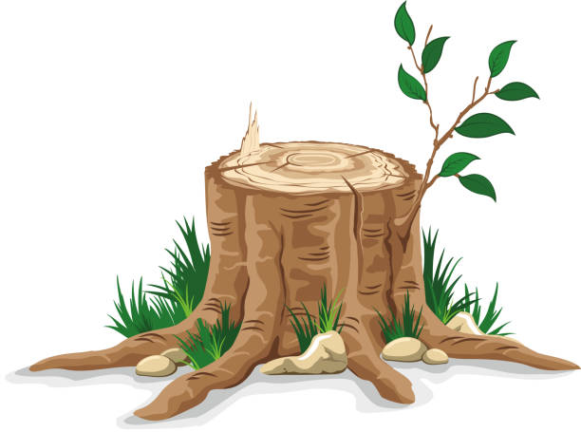
Promise Kept Alive
Through the Prophets
“There shall come forth a Rod from the stem of Jesse, and a Branch shall grow out of his roots” (Isaiah 11:1).

Slide 13
Promise Kept Alive
Through the Prophets
“Behold, the days are coming,” says the Lord, “That I will raise to David a Branch of righteousness; a King shall reign and prosper, and execute judgment and righteousness in the earth.
In His days Judah will be saved, and Israel will dwell safely; now this is His name by which He will be called: THE LORD OUR RIGHTEOUSNESS.
Jeremiah 23:5-6

Slide 14
Promise Kept Alive
Through the Prophets
Hear, O Joshua, the high priest, you and your companions who sit before you, for they are a wondrous sign; for behold, I am bringing forth My Servant the BRANCH.
Zechariah 3:8

Slide 15
Promise Kept Alive
Through the Prophets
Then speak to him, saying, “Thus says the Lord of hosts, saying: ‘Behold, the Man whose name is the BRANCH! From His place He shall branch out, and He shall build the temple of the Lord;
Yes, He shall build the temple of the Lord. He shall bear the glory, and shall sit and rule on His throne; so He shall be a priest on His throne, and the counsel of peace shall be between them both.’”
Zechariah 6:12-13

Slide 16
Jesus is this BRANCH

Slide 17
Jesus is this BRANCH
“The book of the genealogy of Jesus Christ, the Son of David, the Son of Abraham” (Matt. 1:1).
“Concerning His Son Jesus Christ our Lord, who was born of the seed of David according to the flesh” (Rom. 1:3).

Slide 18
Jesus is this BRANCH
He will be great, and will be called the Son of the Highest; and the Lord God will give Him the throne of His father David.
And He will reign over the house of Jacob forever, and of His kingdom there will be no end.
Luke 1:32-33

Slide 19
Jesus is this BRANCH
Who has believed our report? And to whom has the arm of the Lord been revealed?
For He shall grow up before Him as a tender plant, and as a root out of dry ground. He has no form or comeliness; and when we see Him, there is no beauty that we should desire Him.
Isaiah 53:1-2

Slide 20
“I, Jesus, have sent My
angel to testify to you these things in the churches.
I am the Root and the Offspring of David,
the Bright and Morning Star.”
Revelation 22:16

