Slide 2
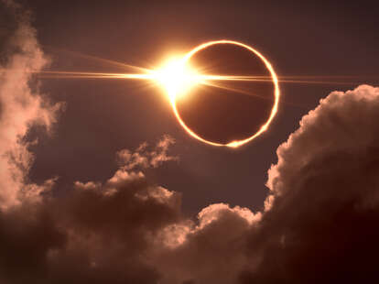
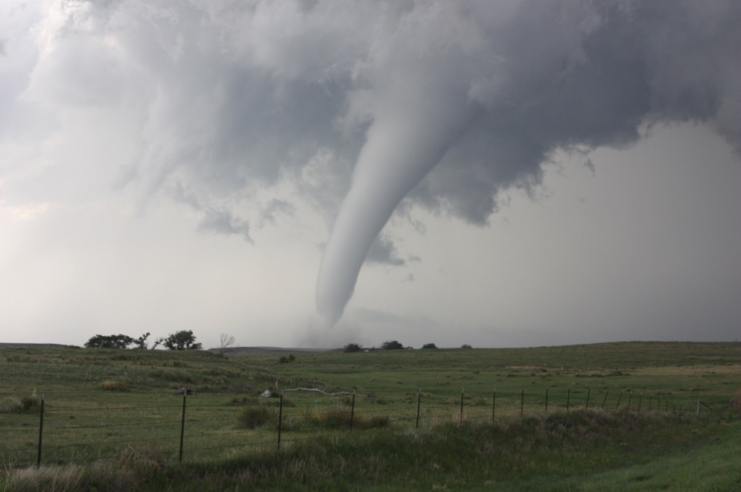
Solar Eclipses and Tornadoes

Slide 3
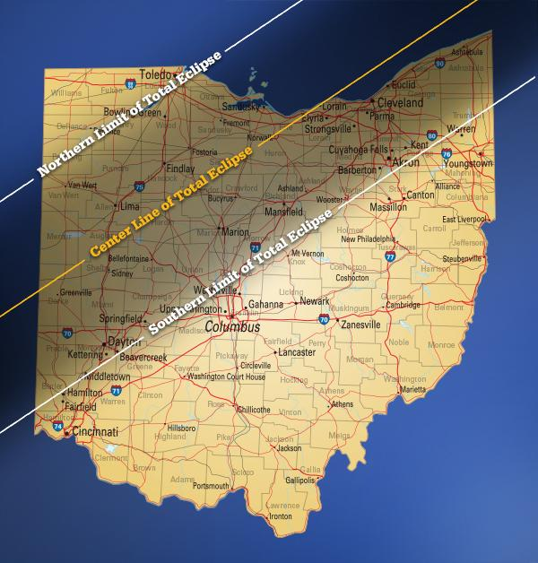
Begins at 1:53 pm
Totality at 3:10 pm
Ends at
4:25 pm

Slide 4
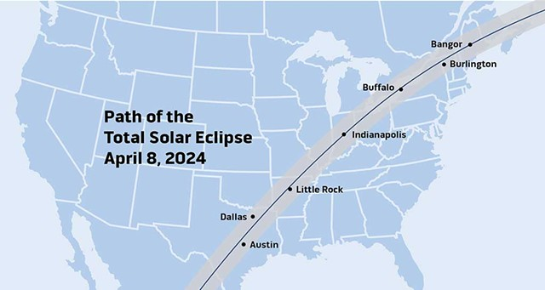
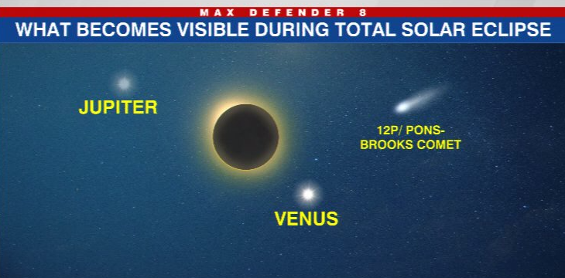

Slide 5

Last total solar eclipse - 1806
Next total solar eclipse - 2099

Slide 6
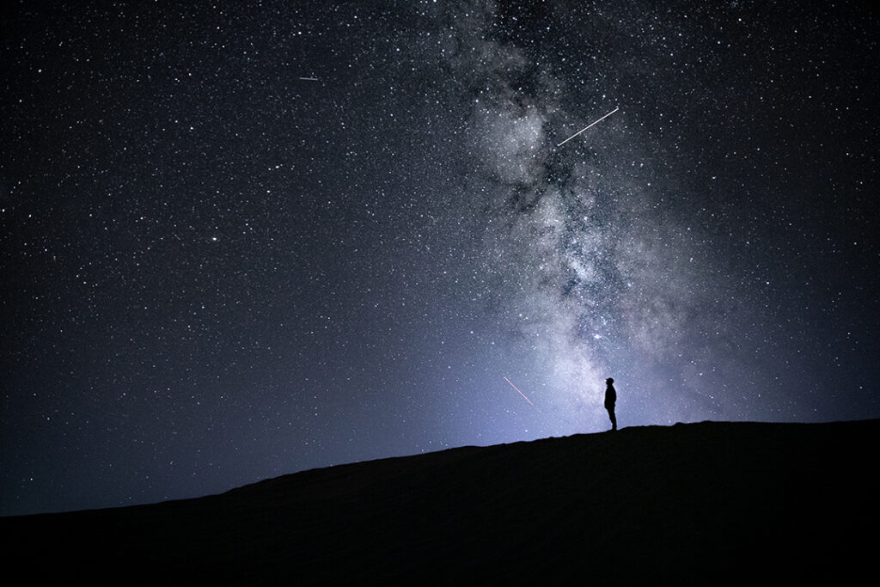
The heavens declare the glory of God; and the firmament shows His handiwork.
Psalm 19:1

Slide 7
The universe obeys laws
God put in place.
“Thus says the Lord: ‘If My covenant is not with day and night, and if I have not appointed the ordinances of heaven and earth…’”
Jeremiah 33:25

Slide 8
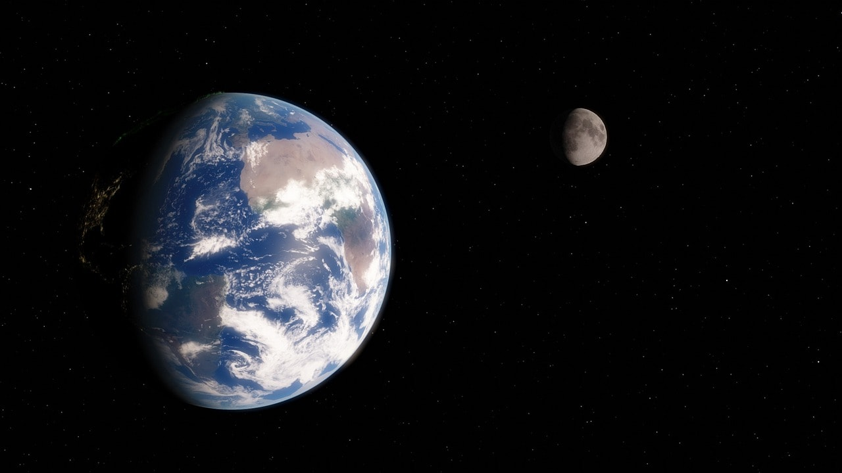

Slide 9
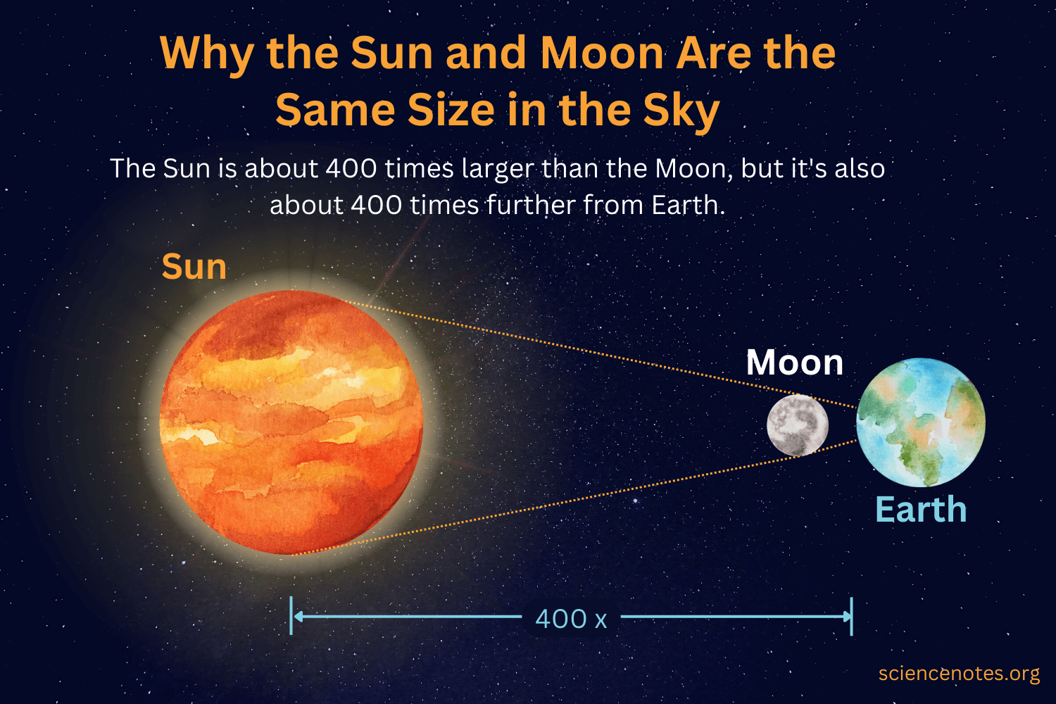

Slide 10
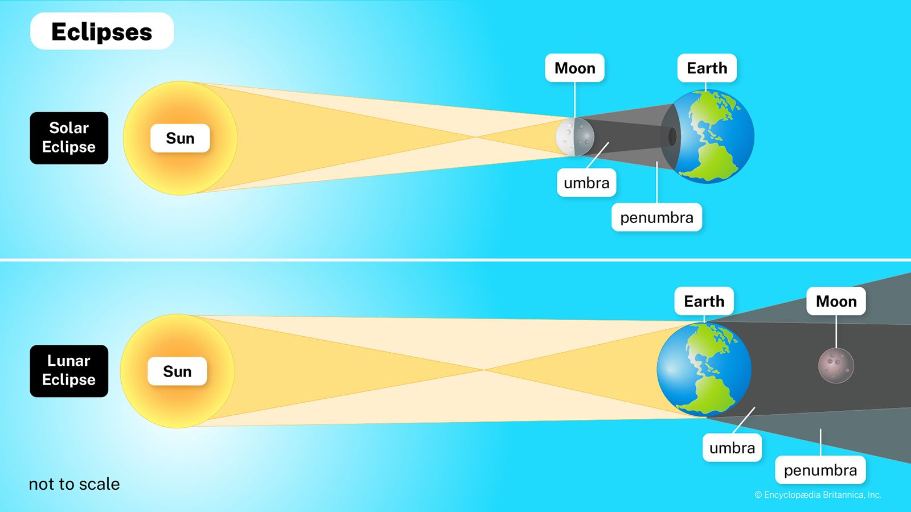

Slide 11
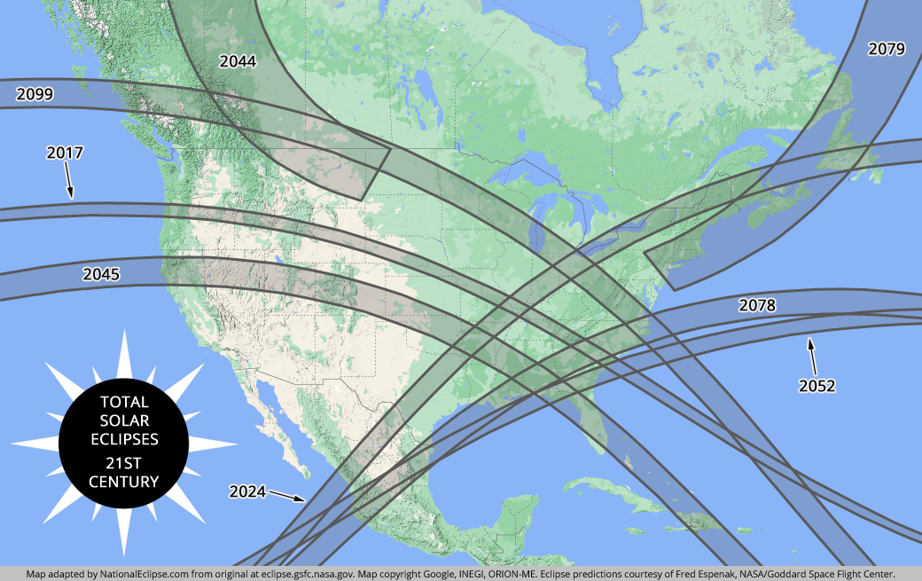

Slide 12
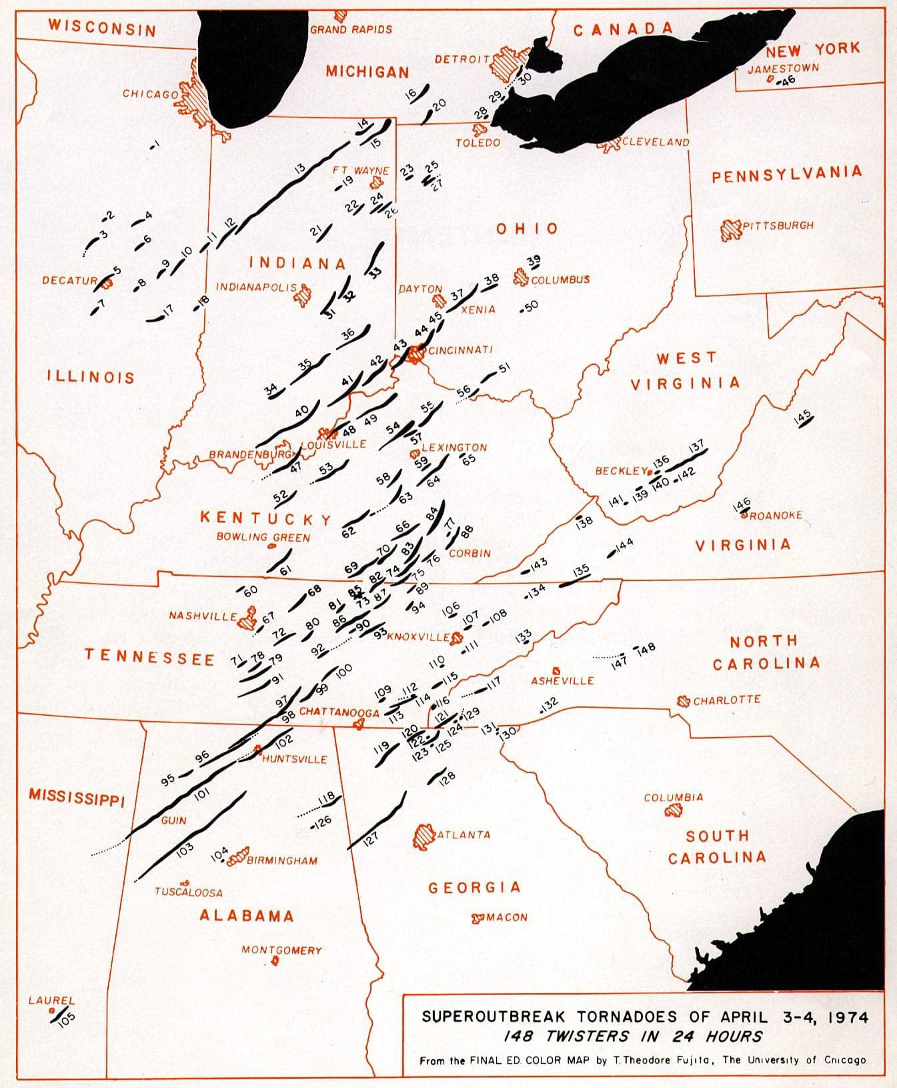

Slide 13
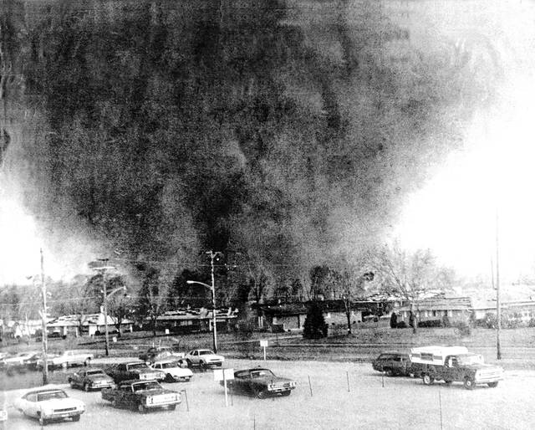
Xenia Tornado April 3, 1974

Slide 14
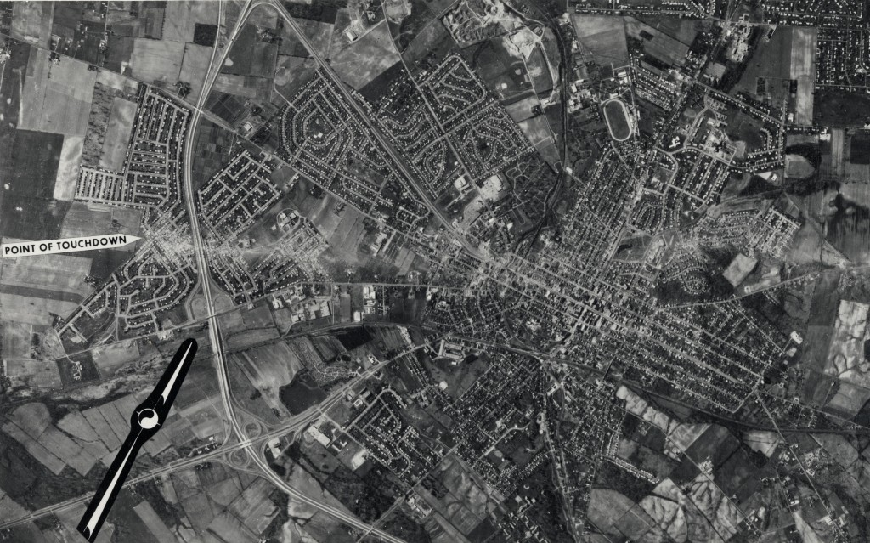
Xenia Tornado April 3, 1974

Slide 15
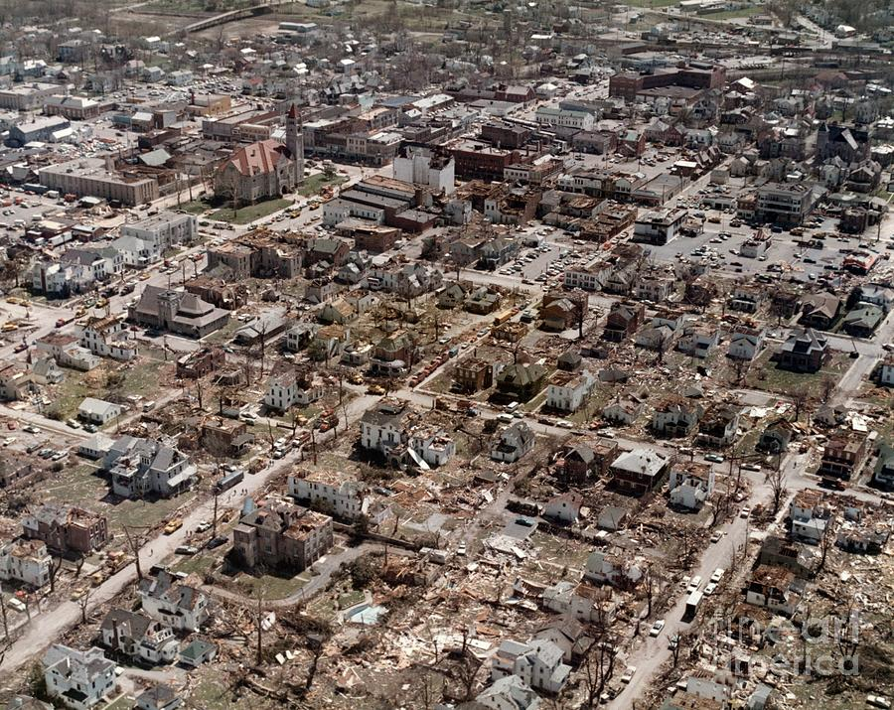
Xenia Tornado April 3, 1974

Slide 16
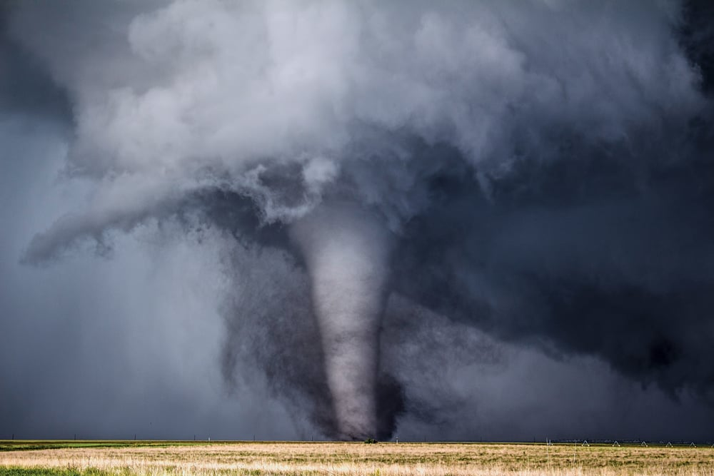

Slide 17
God’s Presence
Then I looked, and behold, a whirlwind was coming out of the north, a great cloud with raging fire engulfing itself; and brightness was all around it and radiating out of its midst like the color of amber, out of the midst of the fire.
Ezekiel 1:4

Slide 18
God’s Presence
The Lord has His way in the whirlwind and in the storm, and the clouds are the dust of His feet.
Nahum 1:3 b

Slide 19
God’s Presence
“Then the Lord answered Job
out of the whirlwind…”
Job 38:1; 40:6

Slide 20
God’s Power
Psalm 29
The Psalm of the Thunderstorm

Slide 21
God’s Judgment
Behold, a whirlwind of the Lord has gone forth in fury - a violent whirlwind! It will fall violently on the head of the wicked.
Jeremiah 23:19

Slide 22
God’s Judgment
Behold, the whirlwind of the Lord goes forth with fury, a continuing whirlwind; it will fall violently on the head of the wicked.
Jeremiah 30:23

Slide 23
Does God Cause Such?
Without direct revelation, we can’t tie every disaster to God’s judgment on a specific person.
We live in a world of time and chance (Eccl. 9:11).
Jesus taught against
such conclusions
(Luke 13:4-5).

Slide 24
Lessons We Can Learn
Such phenomena should move us to praise and glorify God (Ps. 29:1-2).
Remind us what is truly important.
Remind us of the sudden
and unpredictable nature
of the Lord’s return
(Matt. 24:42-44).

