Slide 2

Studies in the
Sermon on the Mount

Slide 3
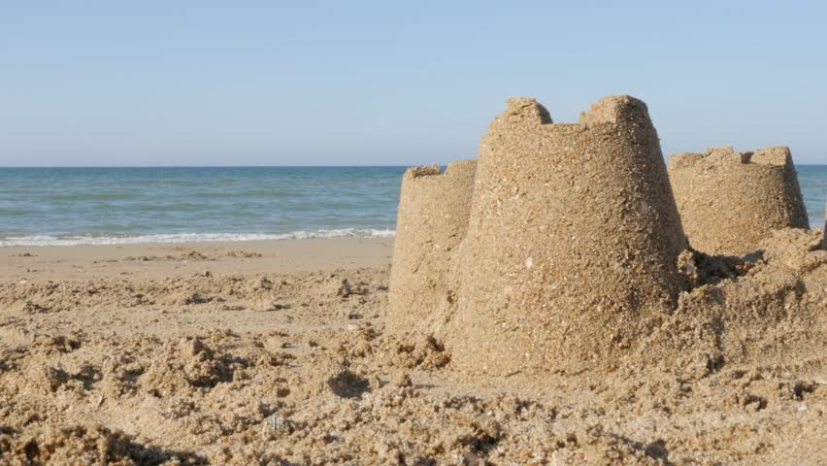
The Wise and Foolish Builders
Matthew 7:24-27

Slide 4
We Are All Building A House
Our lives are built upon our beliefs.
Does God care for us and provide for us, or are we on our own?
Our lives are governed by our values and our priorities.
Are we seeking first the kingdom of God or are we laying up treasures on earth?

Slide 5
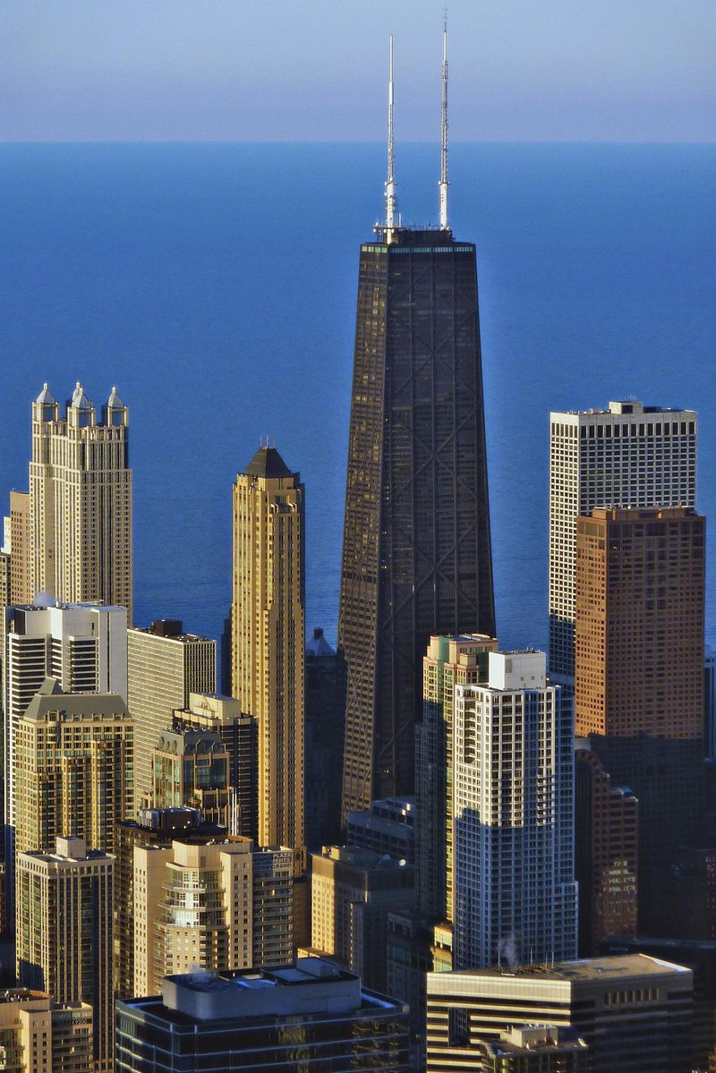
John Hancock Center, Chicago, IL
1,127 feet tall
100 stories
Can see a distance of 80 miles from observatory
Nation’s fastest elevators
Construction began in 1964, completed in 1970

Slide 6
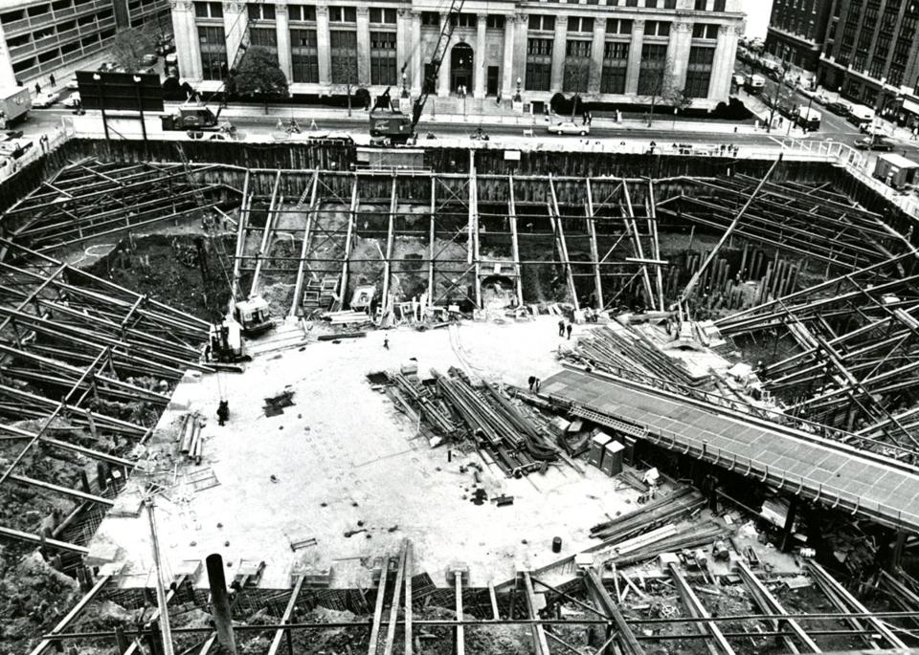

Slide 7
“He is like a man building a house, who dug deep and laid the foundation on the rock…”
Luke 6:48

Slide 8
The foundation for our lives is the Lord’s teaching.
Jesus has stressed genuine faith and total obedience in His sermon.
Obedience is the proper way to…
Express our faith in God (James 2:14-26).
Express our love for God (John 14:15).
Enter the kingdom (Matt. 7:21).

Slide 9
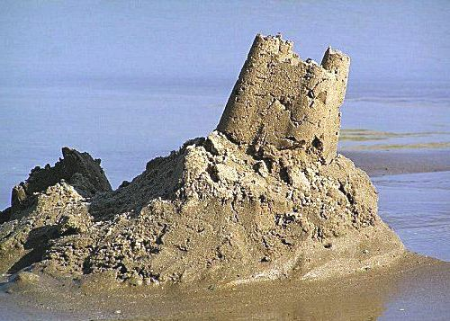
Stand or Fall?
“Great was its fall” (Matt. 7:27).
“The ruin of that house was great” (Lk. 6:49).

Slide 10
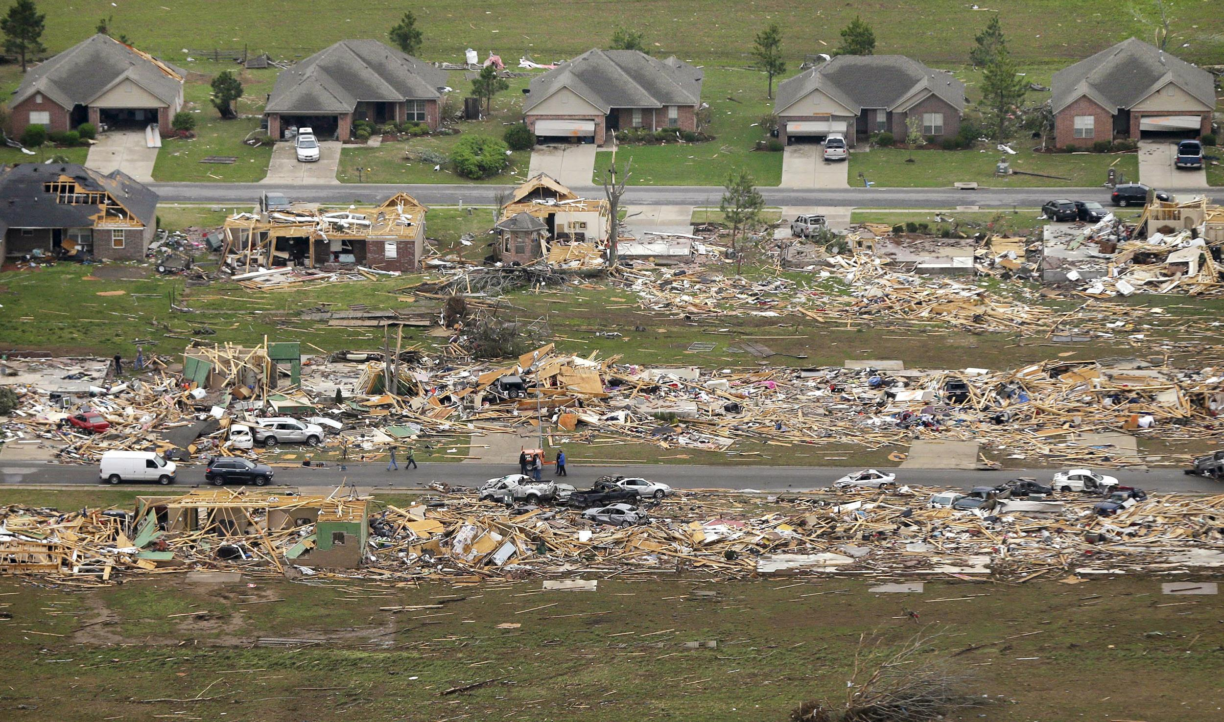
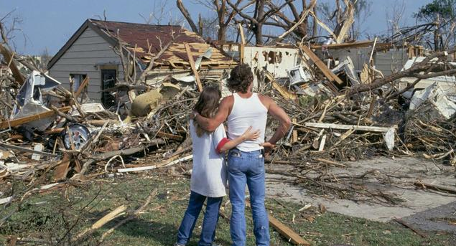
“The ruin of that house was great.”
Luke 6:49

Slide 11
Stand or Fall?
Calling sand “rock” does not make it rock. We are only fooling ourselves.
Knowledge of God’s will is not a solid foundation.
The wise builder is the one who “hears” and “does” what the Lord says (John 13:17).
The time to solidify our foundation is now – before the storms come.

Slide 12
“These Sayings of Mine”
The blessings of being in the kingdom (5:3-12).
Our relationship to and influence upon the world (5:13-16).
The high standards of righteousness in the kingdom (5:17-48).
The proper way to practice our righteousness in the kingdom (6:1-18).
The importance of trusting God and putting the kingdom first in our daily life (6:19-34).
The proper way to treat our fellow man (7:1-12).

Slide 13
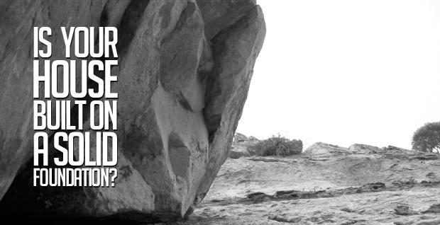
“Not everyone who says to me, “Lord, Lord,’ shall enter the kingdom of heaven, but he who does the will of My Father in heaven.”
“Therefore whoever hears these sayings of Mine, and does them…”

