Slide 2
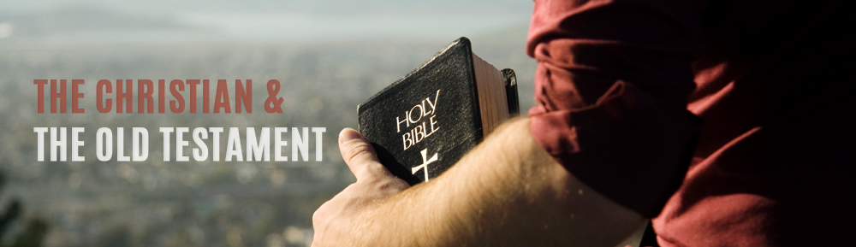

Slide 3

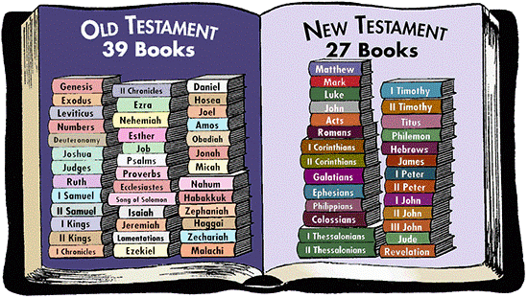
Second Timothy 2:15
Be diligent to present yourself approved to God, a worker who does not need to be ashamed, rightly dividing the word of truth.

Slide 4
1. The Old Testament is Profitable
2 Timothy 3:14-17

Slide 5
1. The Old Testament is Profitable
All Scripture is given by inspiration of God, and is profitable for doctrine, for reproof, for correction, for instruction in righteousness, that the man of God may be complete, thoroughly equipped for every good work.
2 Tim. 3:16-17

Slide 6
1. The Old Testament is Profitable
All Scripture is given by inspiration of God, and is profitable for doctrine, for reproof, for correction, for instruction in righteousness, that the man of God may be complete, thoroughly equipped for every good work.
2 Tim. 3:16-17

Slide 7
1. The Old Testament is Profitable
All Scripture is given by inspiration of God, and is profitable for doctrine, for reproof, for correction, for instruction in righteousness, that the man of God may be complete, thoroughly equipped for every good work.
2 Tim. 3:16-17

Slide 8
1. The Old Testament is Profitable
All Scripture is given by inspiration of God, and is profitable for doctrine, for reproof, for correction, for instruction in righteousness, that the man of God may be complete, thoroughly equipped for every good work.
2 Tim. 3:16-17

Slide 9
1. The Old Testament is Profitable
All Scripture is given by inspiration of God, and is profitable for doctrine, for reproof, for correction, for instruction in righteousness, that the man of God may be complete, thoroughly equipped for every good work.
2 Tim. 3:16-17

Slide 10
2. The New Testament Commends It To Our Use

Slide 11
2. The New Testament Commends It To Our Use
For whatever things were written before were written for our learning, that we through the patience and comfort of the Scriptures might have hope.
Romans 15:4

Slide 12
2. The New Testament Commends It To Our Use
1 Corinthians 10:1-11
“Now these things became our examples…” (v. 6).
“Now all these things happened to them as examples, and they were written for our admonition, upon whom the ends of the ages have come” (v. 11).

Slide 13
2. The New Testament Commends It To Our Use
No NT equivalent to Genesis 1-3.
No better example of dealing with sin of fornication than Joseph (Gen. 39).
Confronting Calvinism (Ezek. 18:20).
Comfort of the Psalms, wisdom of Proverbs.

Slide 14
3. The New Testament Assumes We Know the Old Testament
The OT is the backdrop for the NT.
OT quoted over 700 times in NT.
Book of Hebrews relies heavily upon the Old Testament.
Over 75% of Revelation alludes to OT.
James’ audience knew the prophets and Job (James 5:10-11).
Luke’s audience knew Jonah (11:29-32).

Slide 15
4. Jesus and the Apostles Used the Old Testament
Jesus quoted the OT 78 times.
Called upon His listeners to know the OT (Matt. 21:42, 22:29; Luke 10:26).
Peter’s sermon in Acts 2 is based on Joel 2, Psalms 16 & 110.
Paul preached from the OT Scriptures - Acts 17:2-3, 28:23.

Slide 16
The Old Testament Is Profitable To the Christian
The New Testament Commends the Old Testament To Our Use
The New Testament Assumes We Know and Understand the Old Testament
Jesus and His Apostles Used the Old Testament

