Slide 1

Dangers Facing the Church Today

Slide 2





The Social Gospel

Slide 3


The social gospel is a concept that emphasizes the “whole man” and caters to his “social needs.”
Secular Education
Medical Care
Care for Orphans and Aged
Recreation
Finances
Relationships

Slide 4
1. It Is Not Authorized

Slide 5
1. It Is Not Authorized
“And He put all things under His feet, and gave Him to be head over all things to the church, which is His body, the fullness of Him who fills all in all.”
Ephesians 1:22-23

Slide 6
1. It Is Not Authorized
We Must Respect the Directions of Scripture
“…For He said, See that you make all things according to the pattern shown you on the mountain.”
Hebrews 8:5

Slide 7
1. It Is Not Authorized
We Must Respect the Limitations of Scripture
“Whoever transgresses and does not abide in the doctrine of Christ does not have God. He who abides in the doctrine of Christ has both the Father and the Son.”
2 John 9

Slide 8
The New Testament Gives the Church the Authority To…
Spread the gospel to the lost
1 Tim. 3:15
Edify the members
Eph. 4:11-12
Help needy members
Rom. 15:26

Slide 9
Where is the authority for the church to…
Assemble Heb. 10:25
Preach 1 Tim. 3:15
Sing 1 Cor. 14:15
Instrumental Music ???
Organized Sports ???
Carnivals ???
School, Day Care ???
Sponsor Dinners ???

Slide 10
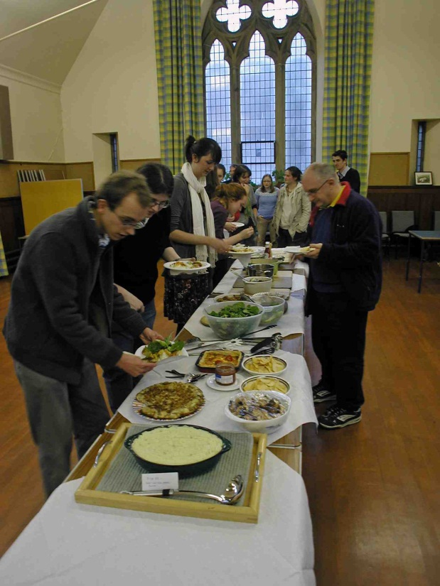
Eating a common meal while assembled as the church is specifically prohibited by both command and example.
1 Cor. 11:20-22
Acts 2:46

Slide 11
2. It Degrades the Church

Slide 12
2. It Degrades the Church
“To the intent that now the manifold wisdom of God might be made known by the church to the principalities and powers in the heavenly places.”
Ephesians 3:10

Slide 13
2. It Degrades the Church
“Therefore take heed to yourselves and to all the flock, among which the Holy Spirit has made you overseers, to shepherd the church of God which He purchased with His own blood.”
Acts 20:28

Slide 14
3. It Cheapens the Cross

Slide 15
3. It Cheapens the Cross
“And I, if I am lifted up from the earth, will draw all peoples to Myself.”
John 12:32

Slide 16
3. It Cheapens the Cross
“No one can come to Me unless the Father who sent Me draws him; and I will raise him up at the last day. It is written in the prophets, ‘And they shall all be taught by God.’ Therefore everyone who has heard and learned from the Father comes to Me.”
John 6:44-45

Slide 17
3. It Cheapens the Cross
“For I am not ashamed of the gospel of Christ, for it is the power of God to salvation for everyone who believes, for the Jew first and also for the Greek.”
Romans 1:16

Slide 18
4. It Fails To Provide True Edification

Slide 19
4. It Fails To Provide True Edification
“So now, brethren, I commend you to God and to the word of His grace, which is able to build you up and give you an inheritance among all those who are sanctified.”
Acts 20:32

Slide 20
4. It Fails To Provide True Edification
“And He Himself gave some to be apostles, some prophets, some evangelists, and some pastors and teachers, for the equipping of the saints for the work of ministry, for the edifying of the body of Christ.”
Ephesians 4:11-12

Slide 21
4. It Fails To Provide True Edification
“All Scripture is given by inspiration of God, and is profitable for doctrine, for reproof, for correction, for instruction in righteousness, that the man of God may be complete, thoroughly equipped for every good work.”
2 Timothy 3:16-17

Slide 22
What Is Wrong With the Social Gospel?
Is Not Authorized
Degrades the Church of the Lord
Cheapens the Cross
Fails To Provide True Edification

